Slide 1

Project Presentation:
Virtual Trial Room(VTR)
Centre for Development of Advanced Computing (CDAC), Noida
Submitted by:
Amruta Makar (210920528005)
Deovart Verma (210920528015)
Megha Pandey (210920528025)
Sagar Thorat (210920528033)
Guided By:
Dominic Irudhayaraj

Slide 2
Problem Statement: “A virtual trial room allows shoppers to try on items without touching them. It works by overlaying an item on a live video feed of a customer.”

Slide 3
Introduction:
Our motivation here is to increase the time efficiency and improve the accessibility of clothes try on by creating a virtual dressing room environment. In circumstances like Covid-19 where we can’t physically visit the store for shopping allowing them to virtually try on clothings before purchasing them.

Slide 4
Approach:
The project aims to deliver a virtual model, exploiting latest OpenCV libraries and functions. The program works towards the objective of Image Recognition, Image Segmentation and Classification with the creation of Virtual Trial Room.

Slide 5
Tech STACK:
Python
OpenCV
Flask

Slide 6
Steps Involved:
Extraction of the user from the video stream by using Haar Cascade Classifier
Creation of cloth masks with the help of bitwise operation
Positioning of the cloth masks by using face detection
Resizing of the masks of cloths by using area interpolation.
Superimposition of the masks of cloths on the user.

Slide 7
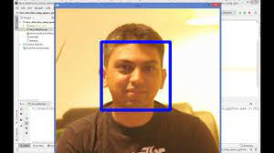
Extraction of the user from the video stream by using Haar Cascade Classifier,
A Haar classifier, or a Haar cascade classifier, is a machine learning object detection program that identifies objects in an image and video.

Slide 8
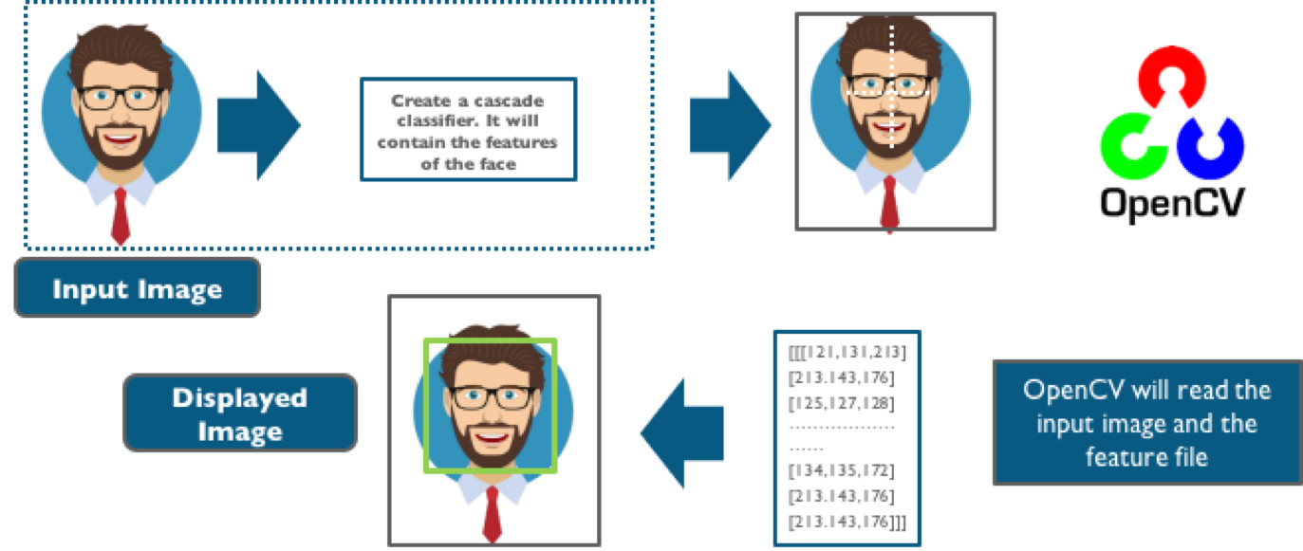
Haar Cascade Classifier

Slide 9
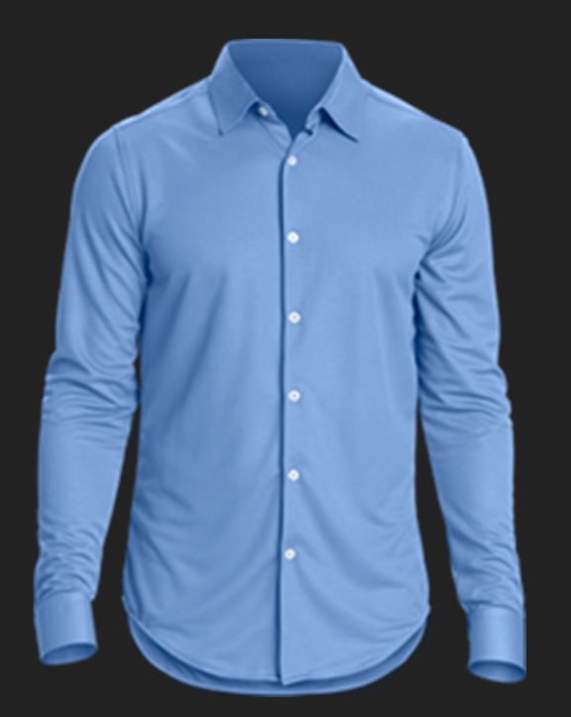
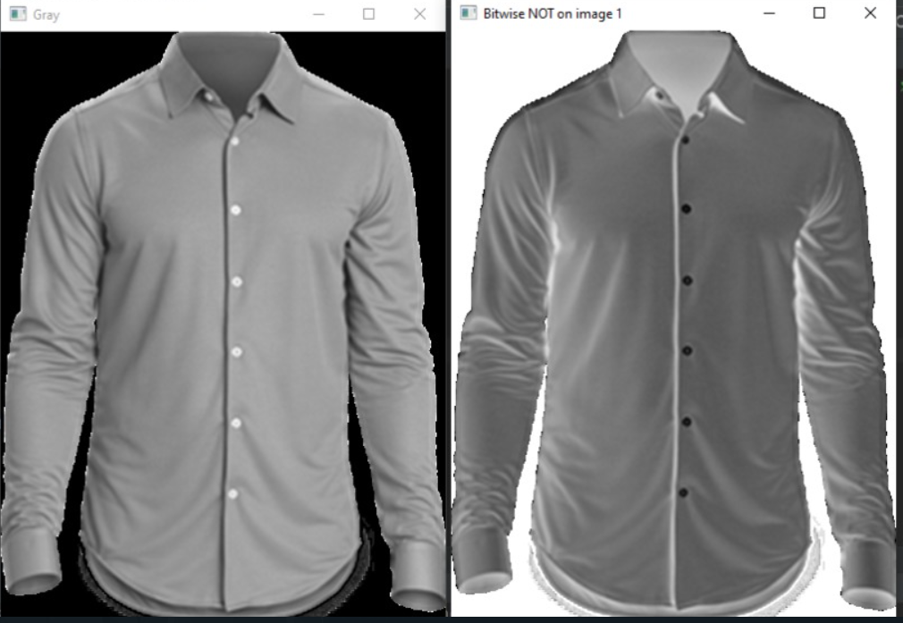
2. Creation of cloth masks with the help of bitwise operation
We take input image of cloth.
Convert that into grayscale to reduce matrix complexity.
Applying bitwise_not operation for mask creation.
Original image Grey scale image Bitwise not image

Slide 10
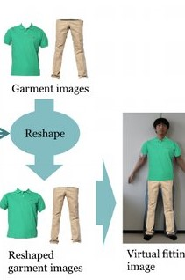
3. Positioning and Resizing of the cloth masks by using face detection
After detecting the user, according to the shape and size of the user
The mask of the cloth which we have created we resized and aligned accordingly

Slide 11
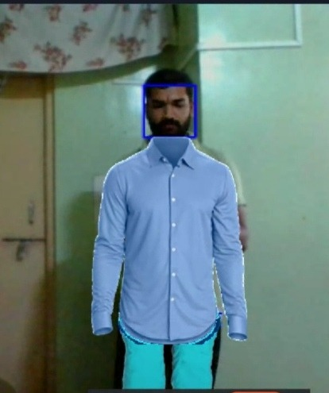
4. Superimposition of the masks of clothes on the user.
The mask created in step 2 is superimposed on the user after positioning and resizing in step 3 using bitwise_and

Slide 12
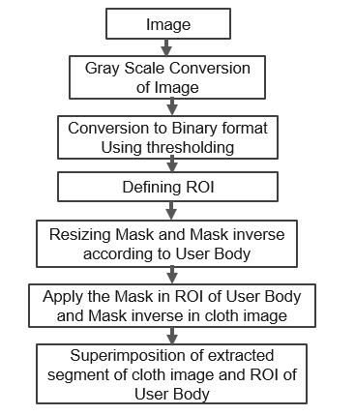
Steps of mask creation and mask application

Slide 13
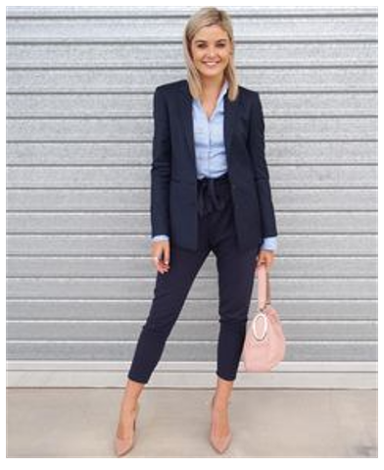
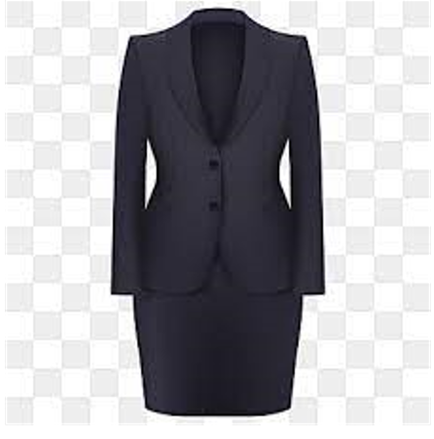
Detected User in Video/Image
Original Image

Slide 14
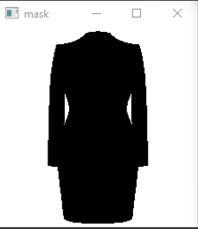
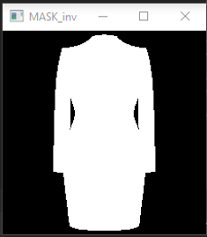
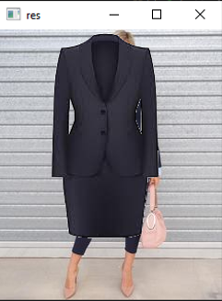
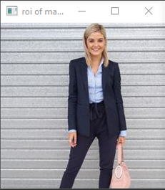
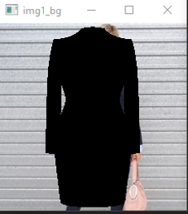
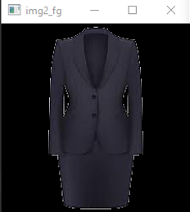
Cloth image
Mask creation
Mask inverse creation
Without Resizing
Put cloth in ROI and modify the main image
Defining ROI in image /video
black-out the area of user in ROI in image /video
Take only region of cloth from cloth image

Slide 15
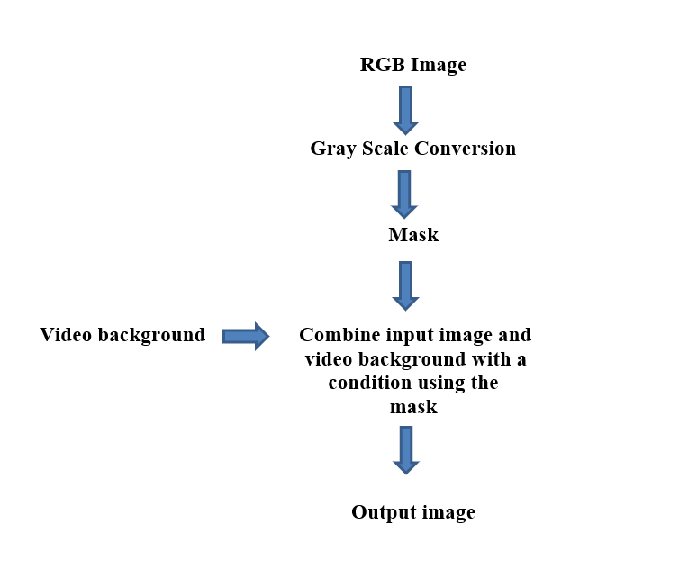
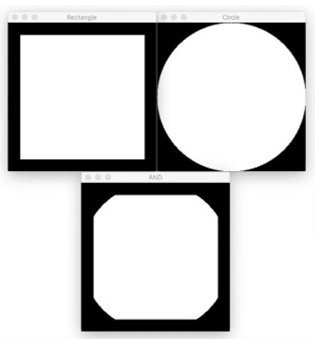
Bitwise_AND operation

Slide 16

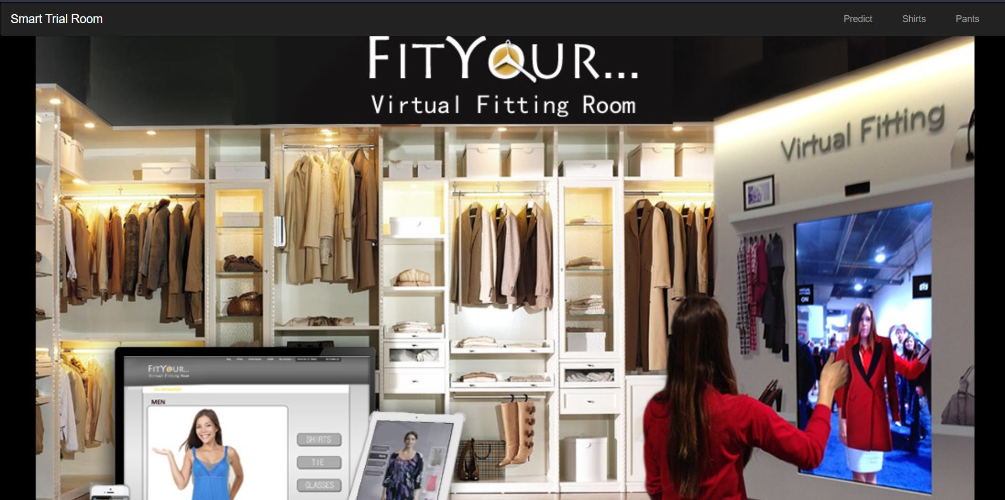
Deployment

Slide 17
Flask Routes

Slide 18
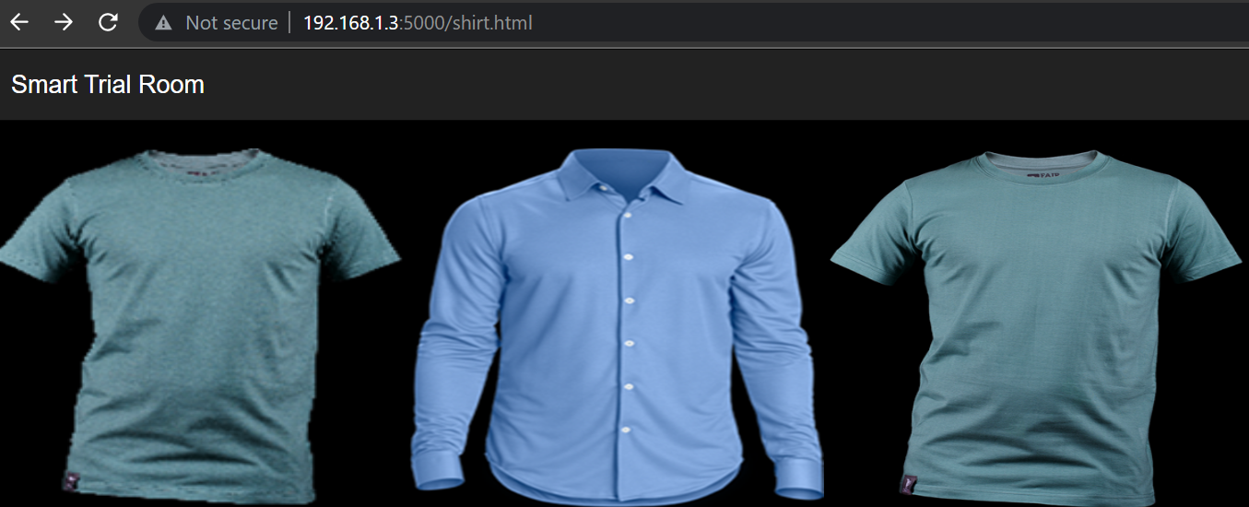
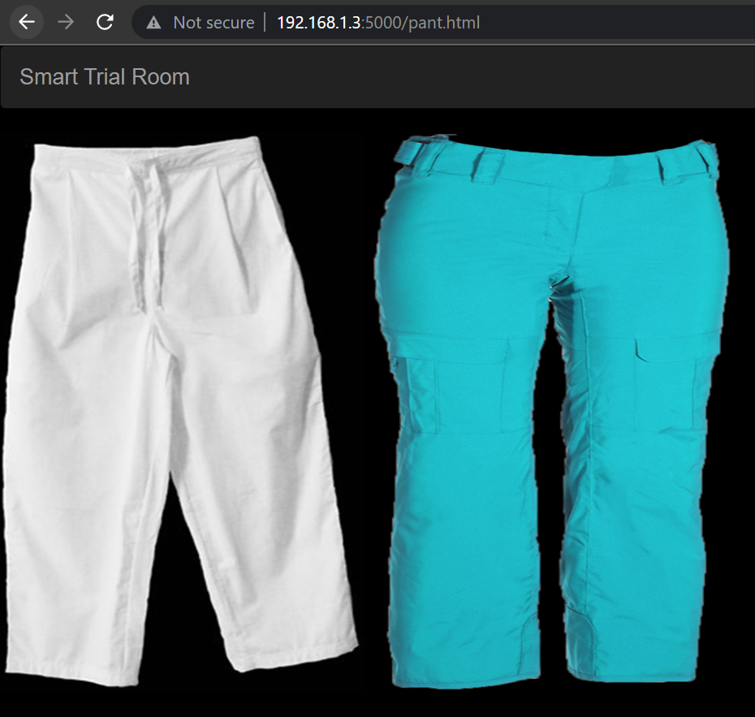
Shirt/Pant Page

Slide 19
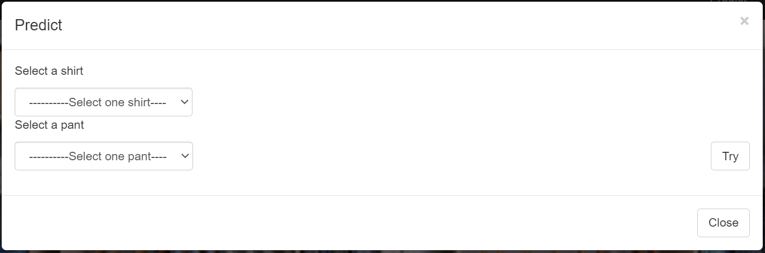
Predict Page

Slide 20
Conclusion:
In this Python project, we have built a Virtual Trial Room.
This model works for both male and female users. This application can be used by any non-technical person. It does not require much technical knowledge. So, it is user friendly.
We successfully used OpenCV and Haar Cascade Classifier to detect user and finding ROI for performing the operations.
Contactless clothing try on can be achieved with the help of this model in Covid-19 like situations.
This model as of now is implemented for 2-D application only.

Slide 21
Future Scope:
There are lots of scope for improvement in this model then in further iterations we will try to build the same on a live video feed of the user, for a 3D modelling.
User 3D Avatars can be created and masking could be done on those avatars.
This model can be integrated with E-commerce platforms.
“The model can be adapted for scalability, better convergence, and better accuracy.”

Slide 22
Thankyou!
For, Centre of Development of Advanced Computing, Noida

